Slide 1

Music Recognition
National Institute of Technology Calicut
Department of Computer Science and Engineering
Naredla Rohith Reddy | B200794CS
Kanchireddy Varshith Reddy | B220832CS
Vangur Ebenezer Rahul Deepak | B200818CS
Guide Name : Manjusha K

Slide 2
Abstract
Our project aims to develop a music recognition system capable of identifying songs even when they are played in the background, sung by ordinary individuals without using instruments, or hummed by someone.
Current music retrieval systems retrieve music from searching artists, phrases in the lyrics etc..
But most users can hum songs which they want to search but there is no open source widely deployed way that could accomplish this
We hope to develop a system which could do this.

Slide 3
Motivation
In the current era, search engine technology has become an indispensable tool for information retrieval.
The majority of search queries revolve around words or images, effectively serving the needs of most requests.
However, for music searches, these common query types often fall short. Frequently, individuals have a melody stuck in their minds (i,e ”earworm”) making traditional searches inadequate.
These are cases where humming the desired song is the most effective approach for a music Retrieval.
The difficulty and frustration of being unable to describe a melody using words or images creates a need for a different, natural method of music search.

Slide 4
BACKGROUND
Pitch : although its definition is not widely agreed upon, pitch represents the perceived frequency of the sound
i.e if we play the 4th, 5th, and 6th harmonics of some fundamental frequency, we actually hear the fundamental frequency, not the harmonics even though the fundamental frequency is not present. This phenomenon was first discovered by Schouten in some pioneer investigations carried out from 1938 to 1940.

Slide 5
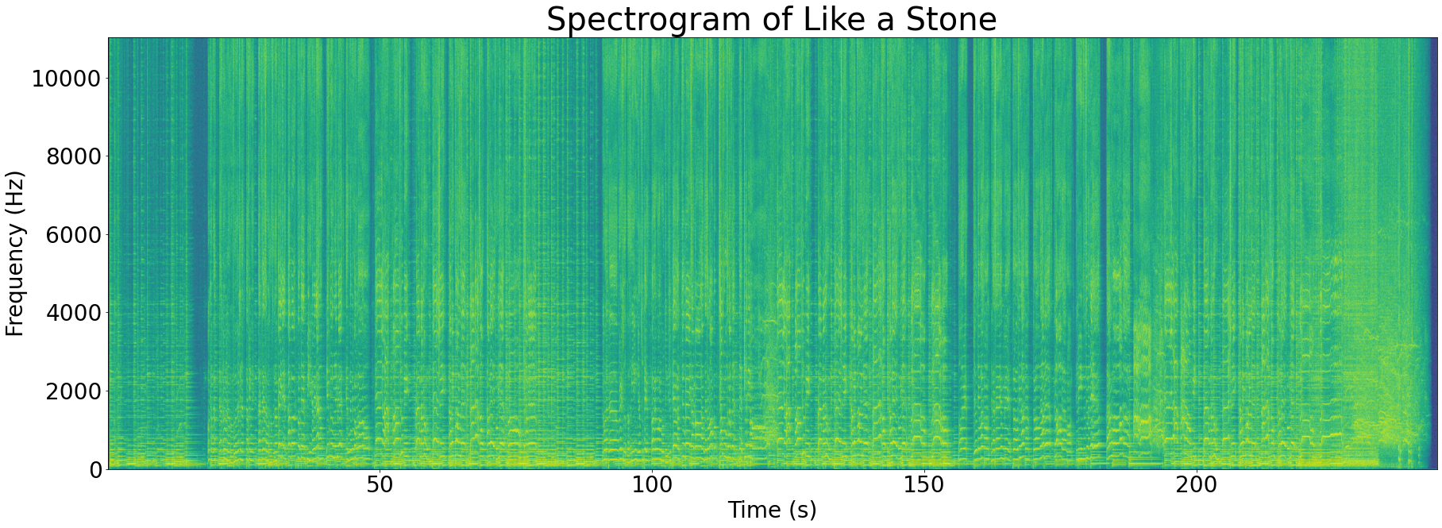
BACKGROUND
Spectrogram
In general we process audio in computers as a spectrogram.
A spectrogram is a visual way of representing the signal strength, or “loudness”, of a signal over time at various frequencies present in a particular waveform.
i.e frequency on y-axis, time on X-axis and colour corresponds to strength.

Slide 6
Background
Melody : perceived movement from pitch to pitch. It's subjective hence no particular definition captures the essence of this.

Slide 7
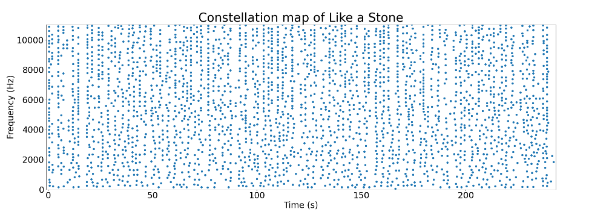
LITERATURE SURVEY
APPROACH 1
This approach can detect songs when they are played in the background in presence of noise etc.
They first convert the audio to a spectrogram.
Then we identify peaks within the songs using a maximum filter.
To sparse the data they selected the top N peaks (N being proportional the length of the song).

Slide 8

LITERATURE SURVEY
And then they form pairs of points and store each pair in the database i.e key being (f1, f2, time_diff).
This procedure relies on the fact that even in the presence of noise the peaks are preserved.
And also saving the pairs of frequencies along with the time difference between them instead of saving each point and their absolute time allows us to search the song efficiently and allows the query to be from any arbitrary section of the song.

Slide 9

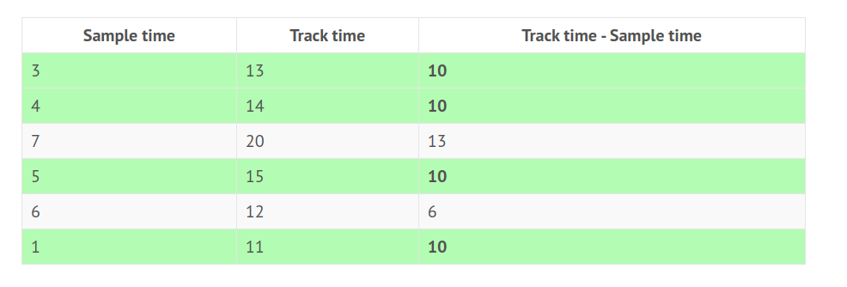
LITERATURE SURVEY
KEY
TIME DIFFERENCE PER SONG

Slide 10
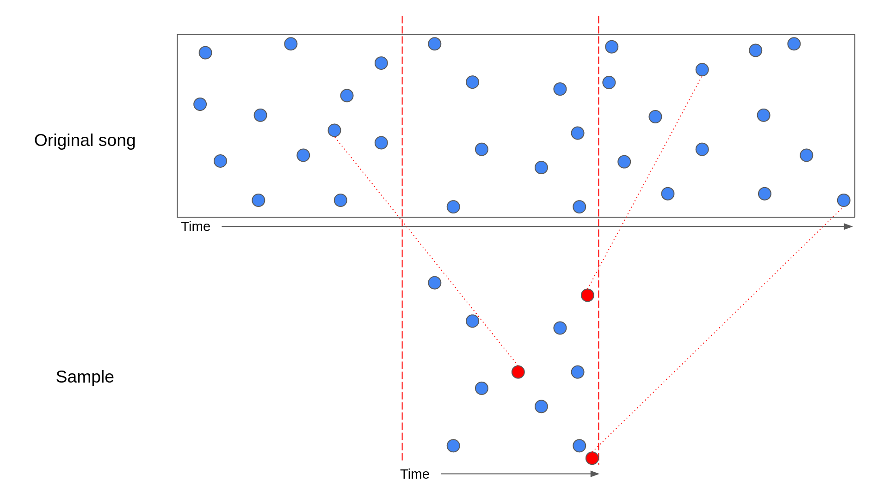
LITERATURE SURVEY

Slide 11
LITERATURE SURVEY
Drawbacks:
The major drawback of this approach is it can only recognise the song when it's played in the background as it uses the fact (f1, f2, time_diff) is invariant
but this is not the case when sung or hummed by a user as they may sing it at a slightly different pace.
And may sing it at a different pitch. And they don’t thereby (f1, f2, time_diff) won’t be the same.
Also There is no guarantee that the peaks would not all be from the instruments thereby not queryable by humming.

Slide 12
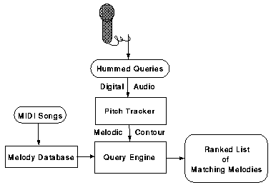
LITERATURE SURVEY
APPROACH 2:
This approach relies on the fact that we distinguish two melodies by their melodic counter (defined as the relative pitch difference).
They transform the audio into a sequence of pitch transitions i.e. S referring to the Same as the previous, D lower than the previous, and U higher than the previous so we transform our query to get a sequence of characters and hand it over to search.
The main components of this approach are the pitch tracker and Query Engine.

Slide 13

LITERATURE SURVEY
The pitch tracker here uses a technique called autocorrelation to generate the sequence.
And then they employ a fuzzy search algorithm to find the best match.
According to their observations They were able to retrieve the correct song within just 12 notes of the hum.

Slide 14
LITERATURE SURVEY
Drawbacks:
The main problem with this technique is it doesn’t scale well with this fuzzy search algorithm over a large set of songs. (As they are not using an inverted Index).
Their pitch tracker is slow as it takes about 45 seconds to pitch track for 10 seconds of 44KHz, 16-bit audio.
And for songs they have used MIDI files not the original song as pitch detection from original songs is quite challenging and cannot be accomplished using the above technique because of multiple sources of sound (i.e. instruments and singers).

Slide 15
LITERATURE SURVEY
Drawbacks:
An Inherent Drawback in using UDS Descriptor is to discriminate / distinguish between two songs in a huge database we need a lot of notes.
So the query will become large and user would have to sing a huge portion of song for results
So it works well if it’s used for a user’s personal collection as the number of songs are very less.

Slide 16
LITERATURE SURVEY
APPROACH 3
This paper modifies previous approach based on their observation of the fact that people tend to hum the song or remember the melody of the sung that is sung by the singer
thus they conclude that indexing the song with UDS descriptor (i.e encoding the song as U, S, D as in [2]) only on the voiced part of the original song will be better so they extract the voice from the original song and then index the song.
They also employ a somewhat more efficient search algorithm.

Slide 17
LITERATURE SURVEY
Drawbacks:
This basically cannot work on OSTs and instrumentals.
The voice extraction isn’t mentioned properly so assuming they indexed the original voiced version of the song.
And there is also the fact that for some songs the melody is in the instruments so it won’t work if the hummed melody is a part of the instruments.

Slide 18
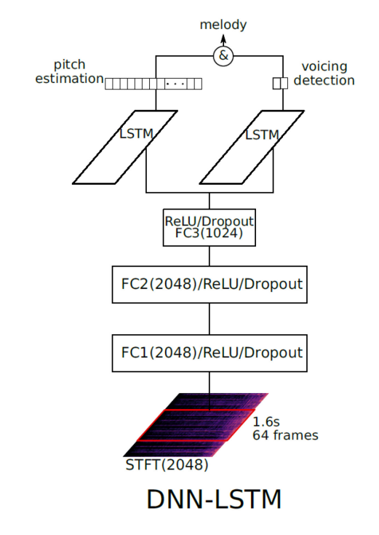
LITERATURE SURVEY
APPROACH 4
These papers use DNN-LSTM to generate a more complex descriptor of the music.
They have used a multitasking model that learns on two tasks: pitch estimation and voicing (i.e., presence of melody or not) detection.
thereby being able to work even on a polyphonic complex musical recording.
The pitch estimation part and the voicing detection part both are classification neural networks.

Slide 19
LITERATURE SURVEY
APPROACH 4
The voicing detection neural network classifies to 1, 0 indicating the presence of melody or not and the pitch-estimation neural network classifies pitch into 540 classes (i.e. their reasoning behind this approach is humans being sensitive to frequencies in the range 55Hz to 1.76 kHz with 1/9 semitone resolution).
After the generation of the sequence, they convert the sequence into a sequence of relative differences in the original sequence and they employ a unified search that uses an n-gram inverted index to search in RP4G, RP3G, and RP2G.

Slide 20
LITERATURE SURVEY
Drawbacks:
The training of this neural network also requires sufficiently high-quality data.

Slide 21
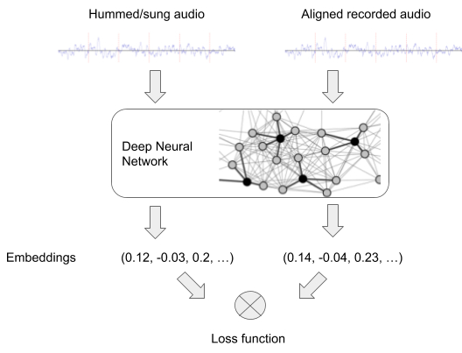
LITERATURE SURVEY
Approach 5
Here the idea is they take two versions of the same song i.e. original song and hum and generate the same embedding for both versions of the song.
They employ a triple loss function.
The search is performed as a closest vector to the embedding.
But they haven’t quite mentioned the exact model that they used
and also how they dealt with the fact that the query can be from any arbitrary section of the song

Slide 22
Further Plans
we need to look at all databases that we have collected so far MIR-QBSH, MTG-QBH, ADC2004, MELEDYDB 2.0, we have requested for MELEDYDB 2.0 but we still haven’t got any response form them yet.
we plan to scrape some sites for new datasets.
we haven’t decide the exact architecture of the system yet, we aim to come up with a unified solution that would perform better in many cases.
we have come up with few approaches for now but haven’t weighted the pros and cons of those approaches yet. so we plan to do that and start design and development of the system.

Slide 23
THANK YOU

